Slide 1
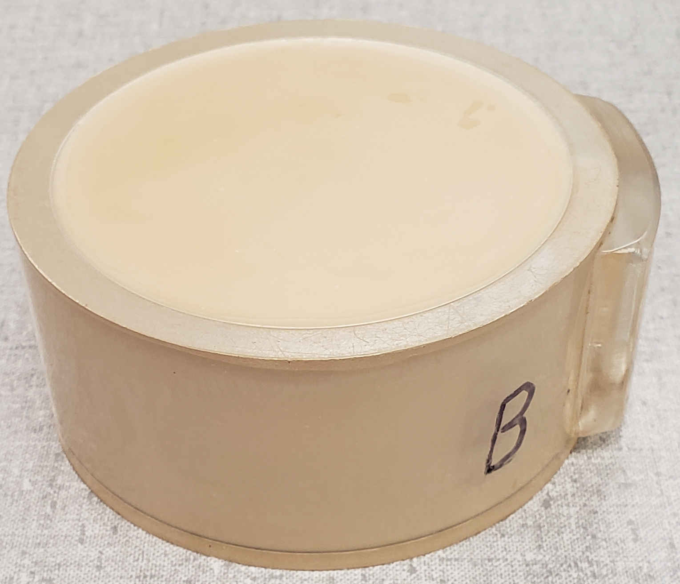
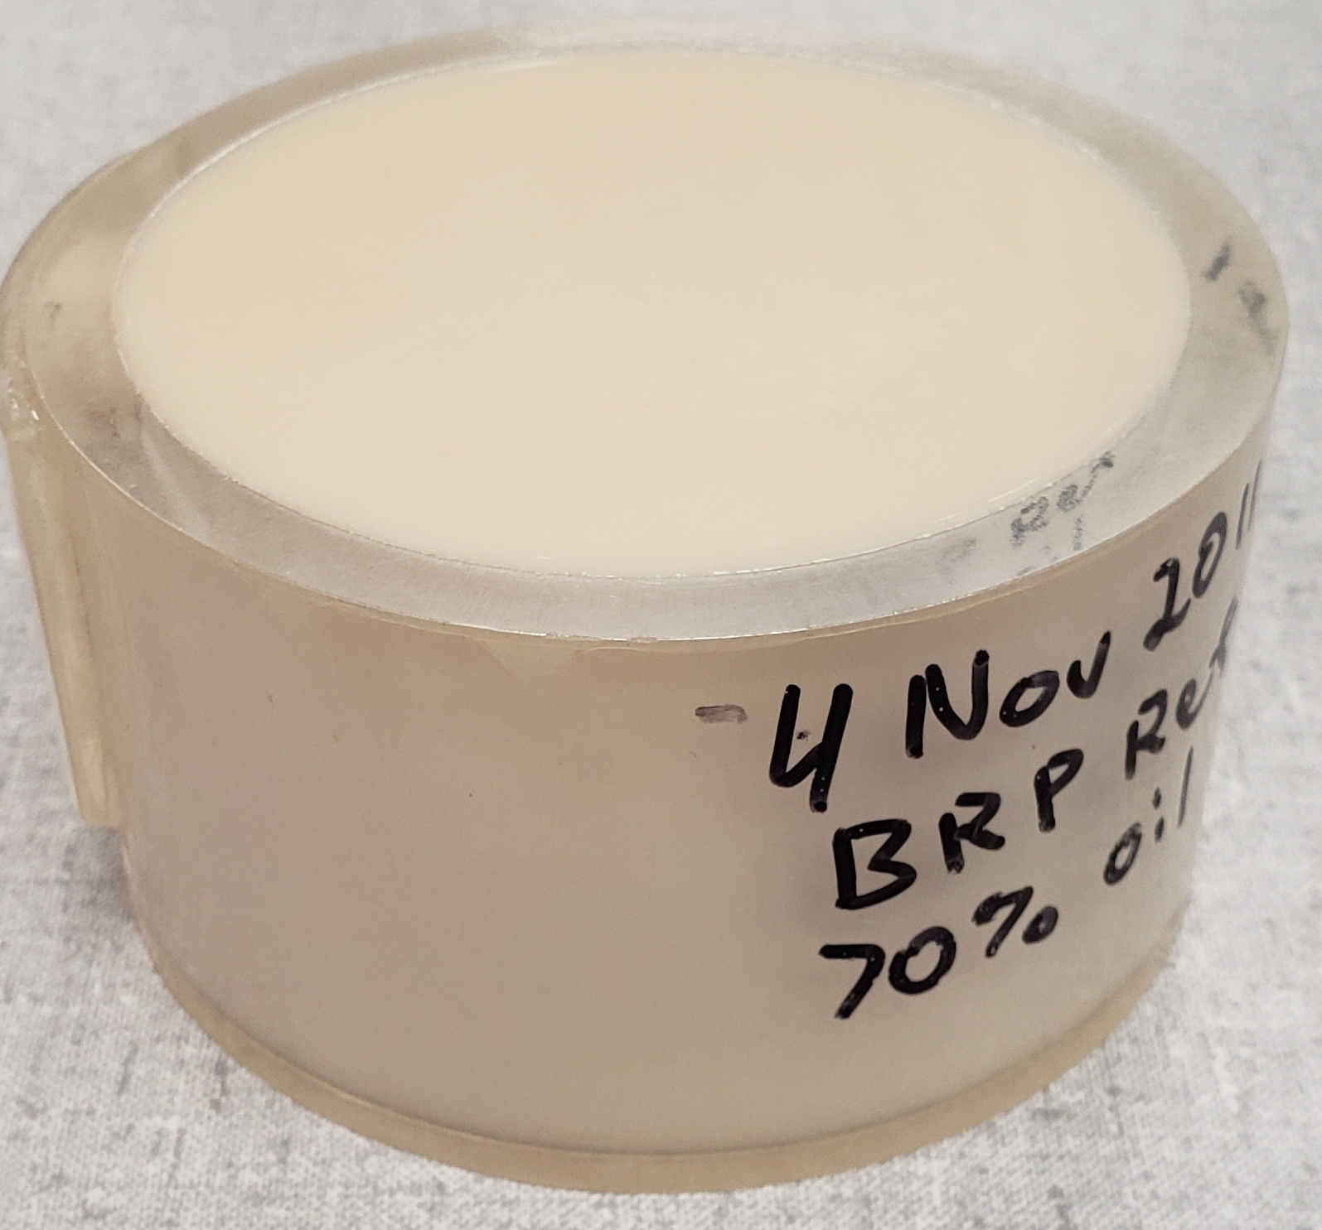
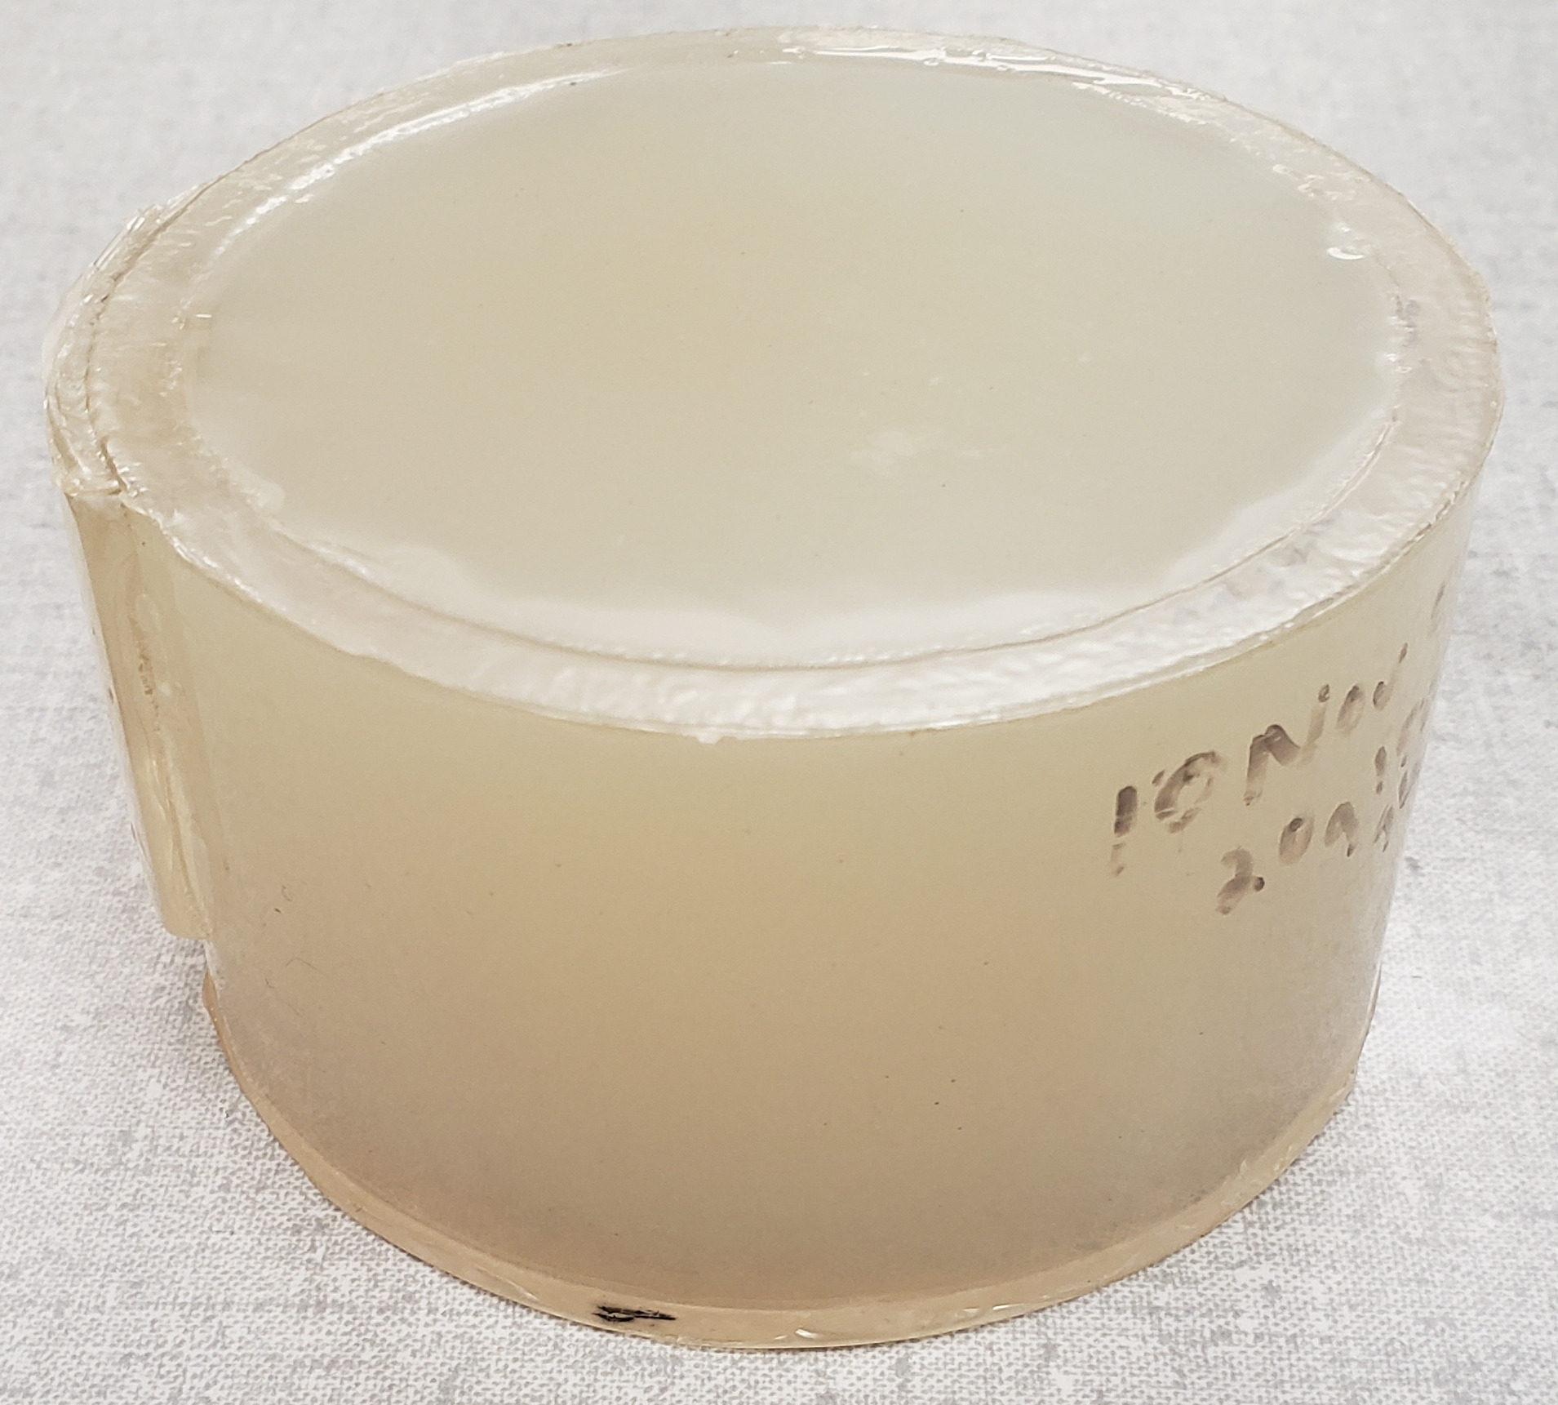
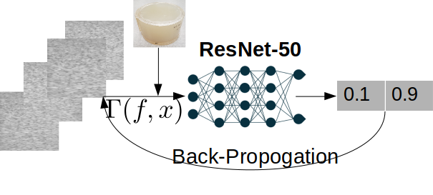
Calibrating Acquisition-Related Data Mismatches
Ufuk Soylu and Michael L. Oelze Department of Electrical and Computer Engineering, College of Engineering, University of Illinois at Urbana-Champaign
INTRODUCTION
There are certain roadblocks to wider clinical adoption of deep learning powered ultrasound imaging. One of the main roadblocks
is data mismatches
between training
and testing data
distribution.
In the context of
ultrasound
imaging, there could
be multiple reasons
that cause
mismatches between
training and testing data, i.e., development and deployment environment such as variations in ultrasound imaging systems, scanner settings or operator experience.
In this work, specifically, we consider acquisition-related data mismatches, i.e., mismatches caused by variations in scanner settings such as the number of foci and their locations or pulse frequency, with the specific task of characterizing tissues based on raw RF data derived from ultrasonic backscatter. Because the clinical environment is too complicated to be fully realized in a development setting where operators are adjusting settings to obtain the best perceived image quality, such data mismatches are pervasive in biomedical ultrasound imaging due to its operator-dependent and patient-dependent nature, and therefore, mitigating their effects is essential for wider clinical adoption of DL-based methods.
Ideally, a large training set at each imaging setting is needed to eliminate data mismatches caused by scanner parameters, which is expensive. Another approach could be training on a subset of imaging settings, which causes generalization issues for the settings that are not included in the training while making the data generation less expensive. The question we address here is "How can we mitigate acquisition-related data mismatches in an inexpensive and generalizable way for ultrasound tissue characterization? "
An ultrasound image can be decomposed as
$$W\left(f,x\right)=S_{ϕ}\left(f,x\right)P\left(f,x\right)$$
where $S_{ϕ}$ is the system response which incorporates all the information related to ultrasound imaging system and $P$ which is the tissue signal that incorporates all the information related to imaging substrate. To calibrate the acquisition-related data mismatches between two system settings, we setup the scenario where the tissue signal, $P$does not change between testing and training, such that
$$\frac{W_{test}\left(f,x\right)}{W_{train}\left(f,x\right)}=\frac{S_{ϕ_{test}}\left(f,x\right)}{S_{ϕ_{train}}\left(f,x\right)}$$
$=Γ\left(f,x\right)$
where $Γ\left(f,x\right)$represents ”the setting transfer function” in train-time that transfers training to testing system parameters. Similarly, $Γ^{−1}\left(f,x\right)$represents ”the setting transfer function” in test-time that transfers testing to training system parameters.
Here is the proposed method step by step at a high-level:
Generate and gather a large amount of training data at a single setting.
Generate and gather a small amount of calibration data at each scanner setting.
Calculate $W_{test}\left(f,x\right)$and $W_{train}\left(f,x\right)$by using the calibration set to calculate the setting transfer function $Γ$and $Γ^{−1}$.
Construct linear phase filters by using the magnitude responses of $Γ$and $Γ^{−1}$.
When a different setting than training setting is being used in the scanning process, calibrate the mismatch by using filters either in the training time or in the testing time in the DL network.
Scanner parameters that were adjusted for each experiment can be found in the following table.
We acquired data from the phantoms via two ways:
Free-Hand: Recording a video of 1,007 frames by free-hand motion for the training and testing.
Stable: After stabilizing the transducer using a bar clamp holder, recording 10 frames from the exact same location in the phantom for the calibration.
Training and Calibration
The models were trained by using cross entropy loss and horizontal flip with 0.5 probability was implemented as a default data augmentation step. The batch number was chosen as 64. We used the Adam optimizer. All implementations were done with the PyTorch library.
For the calibration, a small calibration data set at each scanner setting was obtained via the stable acquisition setup. Then, we first calculated $W_{train}$ and $W_{test}$ by using the calibration set. By taking their ratios, we obtain setting transfer functions $Γ$and $Γ^{−1}$. We implemented the setting transfer functions in a manner inspired by the Wiener filter,
$$Γ_{Wiener}\left(f,x\right)=\frac{\frac{1}{\left|Γ\left(f,x\right)\right|}}{\frac{1}{{\left|Γ\left(f,x\right)\right|}^{2}}+\frac{1}{SNR}}$$
where $SNR$was estimated through the power spectra of $W_{train}$and $W_{test}.$ In this design, when $Γ$is small compared to the noise, the filter acts like a denoising filter. When the $Γ$ is high compared to noise, the filter is equivalent to the original $Γ.$ This provides a robust way to use the complete bandwidth of setting transfer functions.
Test-Time Calibration
Train-Time Calibration
RESULTS
SectionA: Pulse Frequency Mismatch
SectionB: Focus Mismatch
SectionC: Output Power Mismatch
 | Pulse Freq | Focus | Output Power
Training SecA | 9 MHz | 2cm | 0 dB
Testing SecA | 5 MHz | 2cm | 0 dB
Training SecB | 9 MHz | 2cm | 0 dB
Testing SecB | 9 MHz | 1cm&3cm | 0 dB
Training SecC | 9 MHz | 2cm | 0 dB
Testing SecC | 9 MHz | 2cm | -6 dB
Experiment Type | Accuracy
Train-Time Calibration | 95.30 ± 1.40
Test-Time Calibration | 91.72 ± 1.54
No Calibraiton | 55.27 ± 3.83
Benchmark | 99.61 ± 0.11
P_{test}
decision boundary
P_{train}
Experiment Type | Accuracy
Train-Time Calibration | 92.99 ± 1.21
Test-Time Calibration | 88.57 ± 2.79
No Calibraiton | 64.36 ± 2.09
Benchmark | 99.61 ± 0.11
Experiment Type | Accuracy
Train-Time Calibration | 99.32 ± 0.27
Test-Time Calibration | 99.50 ± 0.17
No Calibraiton | 70.32 ± 6.10
Benchmark | 99.61 ± 0.11
CONCLUSIONS
We demonstrated that the proposed approach for mitigating the effects of data mismatches was effective for tissue classification by ultrasound imaging under various scanner setting mismatch types: a pulse frequency mismatch, a focal region mismatch and an output power mismatch. Therefore, the incorporation of transfer functions between scanner settings can provide an economical means of generalizing a DL model for specific imaging tasks where scanner settings are not fixed by the operator.
METHODS
Phantoms
Two different tissue-mimicking phantoms were classified in the experiments, which we designated as Phantom1 and Phantom2, and another phantom was used as the calibration phantom.
Ultrasound Imaging Device and Imaging Settings
The phantoms were scanned with an L9-4/38 transducer using a SonixOne system. Ultrasound frames of post-beamformed RF data sampled at 40 MHz were acquired from each of the phantoms and saved for offline processing. The ultrasound post-beamformed RF data were directly used in the training, test and calibration.
THEORY
We develop a method by looking at the problem from a signals and systems perspective and propose to utilize a small calibration set acquired at all testing scanner settings. Ultrasound imaging can be viewed as a system, which encodes all the information related to an imaging system working on a tissue signal, which encodes all the information related to an imaging substrate. Subsequently, an image obtained by an ultrasound imaging system can be decomposed into two parts: a system response and a tissue signal. Then, the problem of acquisition-related data mismatch can be posed as matching system responses of training and testing.
ACKNOWLEDGEMENTS
This work was funded by grants from the NIH (R01CA251939, R21EB023403 and R21EB024133).
Phantom1
Phantom2
The Calibration Phantom

